Slide 1
Patient-derived cell lines in Merkel Cell Carcinoma Collaboration with Wu and Decaprio Labs
Keegan Korthauer
Rafa Lab Meeting
16 November 2018

Slide 2
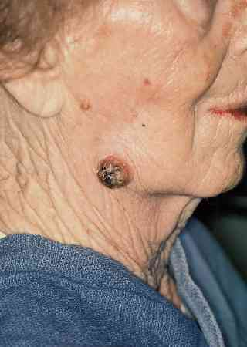
Merkel cell carcinoma (MCC)
Rare and highly aggressive neuroendocrine skin cancer
Two disparate etiologies with similar treatment response rates
60-80% are viral mediated (Merkel Cell Polyomavirus)
Remaining are due to mutations due to Sun/UV exposure
Hypothesized that MCC tumors hide from the immune system due to antigen presentation defects
Notes:
Viral mediated tumor theoretically should have viral antigens that are foreign to immune system.
UV mediated version have high neoantigen load.

Slide 3
Questions of interest
Can we predict candidate immune targets from virus positive and virus negative MCC?
Can we learn the mechanisms by which MCC escapes immunosurveillance?
Can we identify genomic correlates to clinical response?
Can we use patient-derived cell lines to answer these questions?

Slide 4
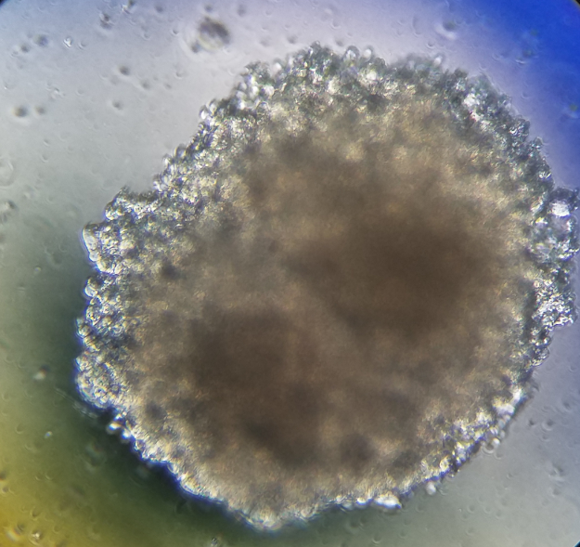
Patient-derived cell lines from tumor samples
Patient-derived tumor cell lines would enable characterization, experimentation, and personalized medicine
Generated 12 lines so far from fresh tumor biopsy material
According to oncopanel markers, cell lines are faithful
Multi-omic data generation in progress:
RNA-seq
WES & WGS
WGBS
ATAC-seq
Mass spec-based histone profiling
Proteomics & Phospho-proteome
HLA-typing

Slide 5
RNA-seq data received so far
MCC ID | Sample Type | Viral Status
336 | Tumor | +?
 | Cell Line
277 | Tumor | +
 | Cell Line
314 | Tumor | +
 | Cell Line
301 | Tumor | +
 | Cell Line
350 | Tumor | -
 | Cell Line
286 | Tumor | ?

Slide 6
Library size normalization of counts

Slide 7
Viral status
Align unmapped reads to reference genome of MCC Polyomavirus
Previously
known + ? + + +? -
viral status:

Slide 8
Unsupervised clustering – all genes
Notes:
286 appears to be an outlier; all other tumor/cell line pairs are matched together

Slide 9
Unsupervised clustering – highly variable genes
Notes:
Using only 1000 HVGs, 286 is still an outlier, but also 350 looks different than other samples as well. Note that 350 is virus negative but all others are virus pos. Here it looks like 286 is clustering with the virus positive samples a bit more.
PCA - loadings make sure not a couple of genes

Slide 10
Highly variable genes – all samples
Notes:
Visualizing the variance-stabilized counts for the top 100 genes in all samples. Rows and columns hierarchically clustered.
We can see stark differences in 350. Not all cell line/ tumor pairs cluster together.

Slide 11
Highly variable genes – viral positive samples only
Notes:
Visualizing the variance-stabilized counts for the top 500 genes excluding samples 350 and 286. Rows and columns hierarchically clustered.
More similarity between cell line / tumor pairs is evident. All cell line / tumor pairs cluster together.

Slide 12
PCA – all samples, all genes
Notes:
Systematic variation across all genes between cell line and tumor captured in PC2

Slide 13
PCA – Highly variable genes, viral positive only
Notes:
Restricting to 500 most highly variable genes, samples from the same patient are more similar to each other than samples from the same preparation type. PC2 still shoes a cell line vs tumor effect, but not as strong.

Slide 14
Immune-related genes
Expression in Immune-related genes
Notes:
The genes of interest appear to cluster more strongly by cell line vs tumor, rather than patient (columns).
Some clustering of gene categories (rows).

Slide 15
Differential expression between tumor and cell line
Notes:
Volcano plot – fold change by –log10 pvalue. orange points are significant at FDR < 0.01.
Positive fold change indicates expression was higher in tumor compared to cell line.

Slide 16
DE genes between tumor and cell line
Notes:
1125 DE genes at FDR < 0.01 between tumor and cell line.

Slide 17
Immune-related genes with differential expression
18 out of 62 immune-related genes (29%) are DE (FDR < 0.01)
Compared to 1,125 out of 27,028 genes overall (4.16%)
In particular, note that this quantity broken down by category is:
0 out of 4 MCC Marker genes (0%)
0 out of 8 MAPK Pathway genes (0%)
2 out of 27 Class I genes (7.41%)
16 out of 23 Class II genes (69.6%)

Slide 18
Differential expression between tumor and cell line
Notes:
Volcano plot – fold change by –log10 pvalue. orange points are significant at FDR < 0.01. Red points are genes of interest. Genes of interest with FDR < 0.01 are labeled.
Positive fold change indicates expression was higher in tumor compared to cell line.

Slide 19
Gene Set Enrichment of DE genes
Enriched in Tumor
Enriched in Cell Lines
Notes:
Next up – compare viral pos to viral negative samples (waiting on them to be sequenced)
Compare somatic mutation profile from WES in tumor/cell lines

